Slide 1

Parallel Programming in C with MPI and OpenMP
Michael J. Quinn

Slide 2
Chapter 17
Shared-memory Programming

Slide 3
Some References
Primary Reference – Michael Quinn, Parallel Programming, McGraw Hill, 2004, Ch 17 (Textbook).
Ohio Supercomputer Center (OSC, www.osc.org) has a online WebCT course on OpenMP. (Need to create a user name and password
Barbara Chapman, Gabrile Jost, and Ruud Van Der Pas, Using OpenMP: Portable Shared Memory Programming, The MIT Press, 2008.
Chandra, Rohit, Dagum, Kohr, Maydan, McDonald, and Menon, Parallel Programming in OpenMP, Morgan Kaufmann, 2001.

Slide 4
Outline
OpenMP
Shared-memory model
Parallel for loops
Declaring private variables
Critical sections
Reductions
Performance improvements
More general data parallelism
Functional parallelism

Slide 5
OpenMP
OpenMP: An application programming interface (API) for parallel programming on multiprocessors
  Compiler directives
  Library of support functions
OpenMP works in conjunction with Fortran, C, or C++

Slide 6
What’s OpenMP Good For?
C + OpenMP sufficient to program multiprocessors
C + MPI + OpenMP a good way to program multicomputers built out of multiprocessors
  IBM RS/6000 SP
  Fujitsu AP3000
  Dell High Performance Computing Cluster

Slide 7
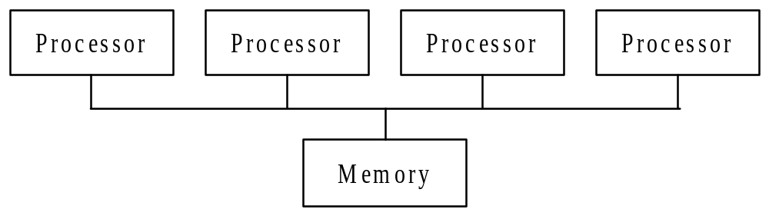
Shared-memory Model
Processors interact and synchronize with each
other through shared variables.

Slide 8
Fork/Join Parallelism
Initially only the master thread is active
Master thread executes sequential code
Fork: Master thread creates or awakens additional threads to execute parallel code
Join: At end of parallel code created threads die or are suspended

Slide 9
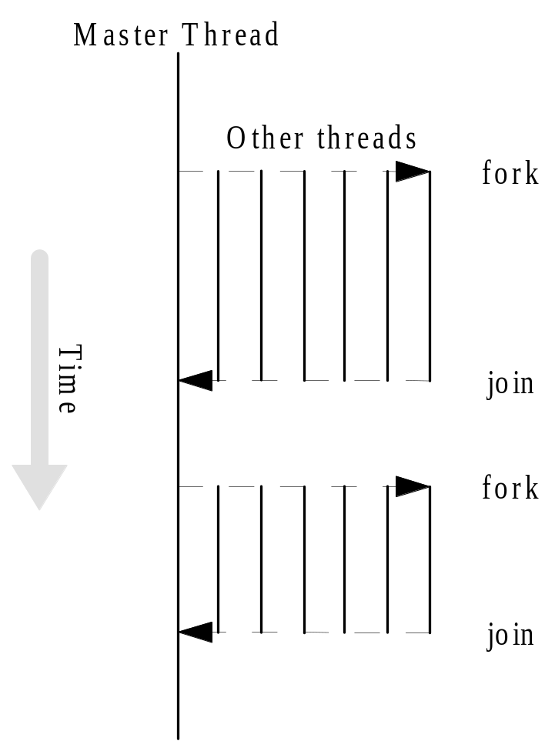
Fork/Join Parallelism

Slide 10
Shared-memory Model vs.
Message-passing Model (#1)
Shared-memory model
  One active thread at start and finish of program
  Number of active threads inside program changes dynamically during execution
Message-passing model
  All processes may be active throughout execution of program

Slide 11
Incremental Parallelization
Sequential program a special case of a shared-memory parallel program
Parallel shared-memory programs may only have a single parallel loop
Incremental parallelization is the process of converting a sequential program to a parallel program a little bit at a time

Slide 12
Shared-memory Model vs.
Message-passing Model (#2)
Shared-memory model
  Execute and profile sequential program
    Sort program blocks according to how much time they take
    Starting first with the most time-consuming blocks
  Incrementally, parallel blocks amendable to parallelization
  Stop when further effort not warranted
Message-passing model
  Sequential-to-parallel transformation requires major effort
  Transformation done in one giant step rather than many tiny steps

Slide 13
Parallel “for Loops”
C programs often express data-parallel operations as for-loops
The following loop accounts for a large portion of the MPI execution time in the Sieve of Eratosthenes in Chapter 5:
for (i = first; i < size; i += prime) marked[i] = 1;
  Clearly, there is no dependence between different iterations in this loop
OpenMP makes it easy to indicate when the iterations of a loop may execute in parallel
Compiler takes care of generating code that forks/joins threads and allocates the iterations to threads

Slide 14
Pragmas
Pragma: a compiler directive in C or C++
Stands for “pragmatic information”
A way for the programmer to communicate with the compiler
Compiler free to ignore pragmas
Syntax:
#pragma omp <rest of pragma>

Slide 15
“Parallel for” Pragma
Format:
#pragma omp parallel for
for (i = 0; i < N; i++)
a[i] = b[i] + c[i];
Compiler must be able to verify the run-time system will have information it needs to schedule loop iterations
Body of for loop must not allow premature exits (e.g., no break, return, exit, or goto statements allowed).

Slide 16
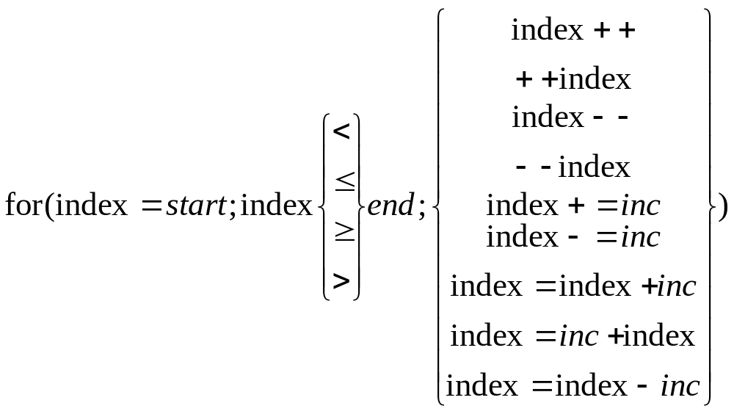
Canonical Shape of for Loop Control Clause

Slide 17
Execution Context
Master thread creates additional threads during parallel execution of a for loop
Every thread has its own execution context:
  I.e., the address space containing all of the variables a thread may access
Contents of ‘execution context’ for a thread:
  static variables
  dynamically allocated data structures in the heap
  variables on the run-time stack
  additional run-time stack for functions invoked by the thread

Slide 18
Shared and Private Variables
Shared variable: has same address in execution context of every thread
Private variable: has different address in execution context of every thread
A thread cannot access the private variables of another thread

Slide 19
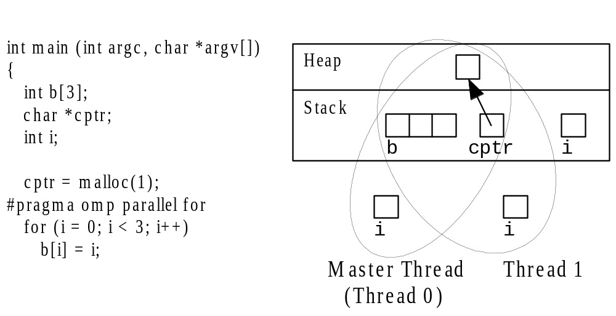
Shared and Private Variables
The index variable i is private
All other variables (e.g., b, cptr, and heap data) are shared

Slide 20
Function omp_get_num_procs
Returns number of physical processors available for use by the parallel program
Function Header is
int omp_get_num_procs (void)

Slide 21
Function omp_set_num_threads
Uses the parameter value to set the number of threads to be active in parallel sections of code
May be called at multiple points in a program
  Allows tailoring level of parallelism to characteristics of the code block.
Function header is
void omp_set_num_threads (int t)

Slide 22
Pop Quiz
Write a C program segment that sets the number of threads equal to the number of processors that are available.
Answer: ???

Slide 23
Pop Quiz
Write a C program segment that sets the number of threads equal to the number of processors that are available.
Answer:
int t;
. . . . . .
t = omp_get_num_proc( );
omp_set_num_threads(t);

Slide 24
Declaring Private Variables
Heart of computation for Floyd’s “all pairs shortest path” algorithm in Chapter 6:
  for (i = 0; i < BLOCK_SIZE(id,p,n); i++)
  for (j = 0; j < n; j++)
  a[i][j] = MIN(a[i][j],a[i][k]+tmp);
Either loop could be executed in parallel
We prefer to make outer loop parallel, to reduce number of forks/joins
Each thread needs its own private copy of variable j
  Otherwise all threads try to initialize and increment same shared variable j
  Result: Some threads will probably not execute all n iterations

Slide 25
Grain Size
Grain size is the number of computations performed between communication or synchronization steps
Increasing grain size usually improves performance for MIMD computers

Slide 26
private Clause
Clause - an optional, additional component to a pragma
Private clause - directs compiler to make one or more variables private
private ( <variable list> )

Slide 27
Example Use of Private Clause
#pragma omp parallel for private(j)
for (i = 0; i < BLOCK_SIZE(id,p,n); i++)
for (j = 0; j < n; j++)
a[i][j] = MIN(a[i][j],a[i][k]+tmp);
Comments:
Here the private variable j is undefined -
  when this parallel construct is entered
  when this parallel construct is exited

Slide 28
firstprivate Clause
Used to create private variables having initial values identical to the variable controlled by the master thread as the loop is entered
Variables are initialized only when thread is created, not once per loop iteration
If a thread modifies a variable’s value in an iteration, subsequent iterations will get the modified value

Slide 29
lastprivate Clause
Sequentially last iteration: iteration that occurs last when the loop is executed sequentially
lastprivate clause: used to copy back to the master thread’s copy of a variable the private copy of the variable from the thread that executed the sequentially last iteration

Slide 30
Critical Sections
Consider this C program segment to compute π using the rectangle rule:
double area, pi, x;
int i, n;
...
area = 0.0;
for (i = 0; i < n; i++) {
x = (i+0.5)/n;
area += 4.0/(1.0 + x*x);
}
pi = area / n;

Slide 31
Race Condition
If we simply parallelize the loop...
double area, pi, x;
int i, n;
...
area = 0.0;
#pragma omp parallel for private(x)
for (i = 0; i < n; i++) {
x = (i+0.5)/n;
area += 4.0/(1.0 + x*x);
}
pi = area / n;

Slide 32
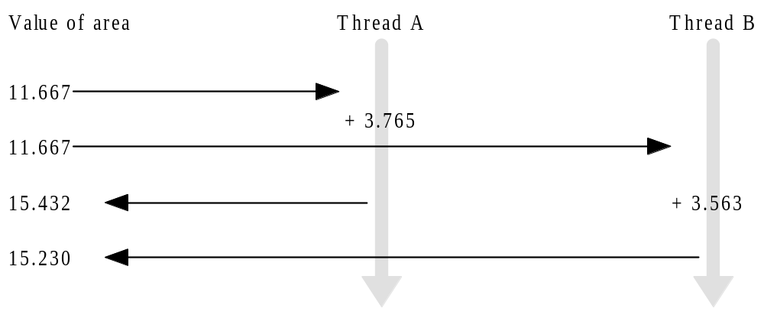
Race Condition Time Line
Thread A reads value of area first
Thread B reads value of area before A can update its value
Thread A updates value of area
Thread B ignores update by A and writes its incorrect value to area

Slide 33
Race Condition (cont.)
A race condition is created in which one process may “race ahead” of another and overwrite the change made by the first process to the shared variable area
11.667
15.432
area
15.230
Answer should be 18.995
11.667
15.432
11.667
15.230
Thread A
Thread B
area += 4.0/(1.0 + x*x)

Slide 34
critical Pragma
Critical section: a portion of code that only thread at a time may execute
We denote a critical section by putting the pragma
#pragma omp critical
in front of a block of C code

Slide 35
Correct, But Inefficient, Code
double area, pi, x;
int i, n;
...
area = 0.0;
#pragma omp parallel for private(x)
for (i = 0; i < n; i++) {
x = (i+0.5)/n;
#pragma omp critical
area += 4.0/(1.0 + x*x);
}
pi = area / n;

Slide 36
Source of Inefficiency
Update to area inside a critical section
Only one thread at a time may execute the statement; i.e., it is sequential code
Time to execute statement significant part of loop
By Amdahl’s Law we know speedup will be severely constrained

Slide 37
Reductions
Reductions are so common that OpenMP provides support for them
May add reduction clause to parallel for pragma
Specify reduction operation and reduction variable
OpenMP takes care of storing partial results in private variables and combining partial results after the loop

Slide 38
reduction Clause
The reduction clause has this syntax:
reduction (<op> :<variable>)
Operators
  + Sum
  * Product
  & Bitwise and
  | Bitwise or
  ^ Bitwise exclusive or
  && Logical and
  || Logical or

Slide 39
π-finding Code with Reduction Clause
double area, pi, x;
int i, n;
...
area = 0.0;
#pragma omp parallel for \
private(x) reduction(+:area)
for (i = 0; i < n; i++) {
x = (i + 0.5)/n;
area += 4.0/(1.0 + x*x);
}
pi = area / n;

Slide 40
Performance Improvement #1
Too many fork/joins can lower performance
Inverting loops may help performance if
  Parallelism is in inner loop
  After inversion, the outer loop can be made parallel
  Inversion does not significantly lower cache hit rate

Slide 41
Performance Improvement #2
If loop has too few iterations, fork/join overhead is greater than time savings from parallel execution
The if clause instructs compiler to insert code that determines at run-time whether loop should be executed in parallel; e.g.,
#pragma omp parallel for if(n > 5000)

Slide 42
Performance Improvement #3
We can use schedule clause to specify how iterations of a loop should be allocated to threads
Static schedule: all iterations allocated to threads before any iterations executed
Dynamic schedule: only some iterations allocated to threads at beginning of loop’s execution. Remaining iterations allocated to threads that complete their assigned iterations.

Slide 43
Static vs. Dynamic Scheduling
Static scheduling
  Low overhead
  May exhibit high workload imbalance
Dynamic scheduling
  Higher overhead
  Can reduce workload imbalance

Slide 44
Chunks
A chunk is a contiguous range of iterations
Increasing chunk size reduces overhead and may increase cache hit rate
Decreasing chunk size allows finer balancing of workloads

Slide 45
schedule Clause
Syntax of schedule clause
schedule (<type>[,<chunk> ])
Schedule type required, chunk size optional
Allowable schedule types
  static: static allocation
  dynamic: dynamic allocation
    Allocates a block of iterations at a time to threads
  guided: guided self-scheduling
    Allocates a block of iterations at a time to threads
    Size of block decreases exponentially over time
  runtime: type chosen at run-time based on value of environment variable OMP_SCHEDULE

Slide 46
Scheduling Options
schedule(static): block allocation of about n/t contiguous iterations to each thread
schedule(static,C): interleaved allocation of chunks of size C to threads
schedule(dynamic): dynamic one-at-a-time allocation of iterations to threads
schedule(dynamic,C): dynamic allocation of C iterations at a time to threads

Slide 47
Scheduling Options (cont.)
schedule(guided, C): dynamic allocation of chunks to tasks using guided self-scheduling heuristic. Initial chunks are bigger, later chunks are smaller, minimum chunk size is C.
schedule(guided): guided self-scheduling with minimum chunk size 1
schedule(runtime): schedule chosen at run-time based on value of OMP_SCHEDULE
  UNIX Example:
  setenv OMP_SCHEDULE “static,1”
  Sets run-time schedule to be interleaved allocation

Slide 48
More General Data Parallelism
Our focus has been on the parallelization of for loops
Other opportunities for data parallelism
  processing items on a “to do” list
  for loop + additional code outside of loop

Slide 49
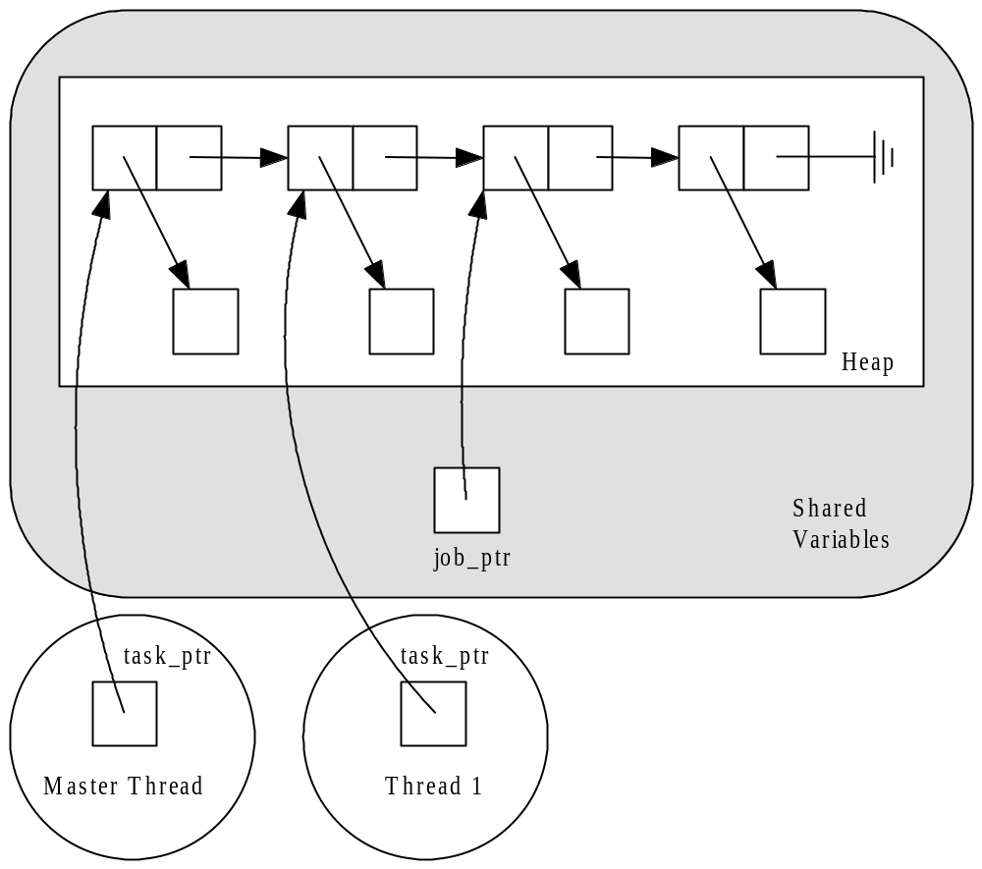
Processing a “To Do” List
Two pointers work their way through a singly linked “to do” list
Variable job-ptr is shared while task-ptr is private

Slide 50
Sequential Code (1/2)
int main (int argc, char *argv[])
{
struct job_struct *job_ptr;
struct task_struct *task_ptr;
...
task_ptr = get_next_task (&job_ptr);
while (task_ptr != NULL) {
complete_task (task_ptr);
task_ptr = get_next_task (&job_ptr);
}
...
}

Slide 51
Sequential Code (2/2)
char *get_next_task(struct job_struct
**job_ptr) {
struct task_struct *answer;
if (*job_ptr == NULL) answer = NULL;
else {
answer = (*job_ptr)->task;
*job_ptr = (*job_ptr)->next;
}
return answer;
}

Slide 52
Parallelization Strategy
Every thread should repeatedly take next task from list and complete it, until there are no more tasks
We must ensure no two threads take same task from the list; i.e., must declare a critical section

Slide 53
parallel Pragma
The parallel pragma precedes a block of code that should be executed by all of the threads
Unlike “parallel for”, the execution is replicated among all threads

Slide 54
Use of parallel Pragma
#pragma omp parallel private(task_ptr)
{
task_ptr = get_next_task (&job_ptr);
while (task_ptr != NULL) {
complete_task (task_ptr);
task_ptr = get_next_task (&job_ptr);
}
}

Slide 55
Use of the critical pragma
Need to ensure function get_next-task executes atomically.
Prevents two threads having the same value for task_ptr.

Slide 56
Critical Section for get_next_task
char *get_next_task(struct job_struct
**job_ptr) {
struct task_struct *answer;
#pragma omp critical
{
if (*job_ptr == NULL) answer = NULL;
else {
answer = (*job_ptr)->task;
*job_ptr = (*job_ptr)->next;
}
}
return answer;
}

Slide 57
Functions for SPMD-style Programming
The parallel pragma allows us to write SPMD-style programs
In these programs we often need to know number of threads and thread ID number
OpenMP provides functions to retrieve this information
This information is used to divide the iterations among the threads.

Slide 58
Function omp_get_thread_num
This function returns the thread identification number
If there are t threads, the ID numbers range from 0 to t-1
The master thread has ID number 0
int omp_get_thread_num (void)

Slide 59
Function omp_get_num_threads
Function omp_get_num_threads returns the number of active threads
If call this function from sequential portion of program, it will return 1
int omp_get_num_threads (void)

Slide 60
SPMD Example
Example of computing π given on pg 423-424
Since area of unit circle is π, the part of the unit circle in first quadrant has area of π/4.
This quarter circle is contained in the unit square whose SW corner is at the origin
The area of the unit square is 1.
The Monte Carlo method can estimate the portion of the circle lying inside square
  Random coordinates (x,y) are generated with 0≤x,y≤1
  The percent of coordinates lying inside circle is approximately the portion of area of square that lies within the circle

Slide 61
SPMD Example
Multiple threads are used to increase accuracy of approximation of π/4
  Different threads generate different sequence of random coordinates in unit square
  Each thread computes the same number of random coordinates and a subtotal of those lying within the unit square
  The total of these subtotals divided into the total number of coordinates generated is the approximate area of the quarter circle.

Slide 62
for Pragma
The parallel pragma instructs every thread to execute all of the code inside the block
If we encounter a for loop inside parallel pragma block that we want to divide among threads, we use the for pragma
#pragma omp for

Slide 63
Example Use of ‘for’ Pragma
#pragma omp parallel private(i,j)
for (i = 0; i < m; i++) {
low = a[i];
high = b[i];
if (low > high) {
printf ("Exiting (%d)\n", i);
break;
}
#pragma omp for
for (j = low; j < high; j++)
c[j] = (c[j] - a[i])/b[i];
}
---------------------------------------------
1st ‘for’ is executed by all threads
2nd ‘for’ divides up inner loop iterations
Creates only single fork/join

Slide 64
single Pragma
Suppose we only want to see the output once
The single pragma directs compiler that only a single thread should execute the block of code the pragma precedes
Syntax:
#pragma omp single

Slide 65
Use of ‘single’ Pragma
#pragma omp parallel private(i,j)
for (i = 0; i < m; i++) {
low = a[i];
high = b[i];
if (low > high) {
#pragma omp single
printf ("Exiting (%d)\n", i);
break;
}
#pragma omp for
for (j = low; j < high; j++)
c[j] = (c[j] - a[i])/b[i];
}
------------------------------------------
‘Single’ pragma tells compiler that only a single thread should execute code block.

Slide 66
‘nowait’ Clause
Compiler puts a barrier synchronization at end of every parallel for statement
Necessary in previous example
  If a thread leaves loop and changes low or high, it may affect behavior of another thread
If ‘low’ & ‘high’ are private variables, then threads can move ahead and reduce execution time

Slide 67
Use of nowait Clause
#pragma omp parallel private(i,j,low,high)
for (i = 0; i < m; i++) {
low = a[i];
high = b[i];
if (low > high) {
#pragma omp single
printf ("Exiting (%d)\n", i);
break;
}
#pragma omp for nowait
for (j = low; j < high; j++)
c[j] = (c[j] - a[i])/b[i];
}

Slide 68
Task/Functional Parallelism
To this point all of our focus has been on exploiting data parallelism
OpenMP allows us to assign different threads to different portions of code
  (task or functional parallelism)

Slide 69
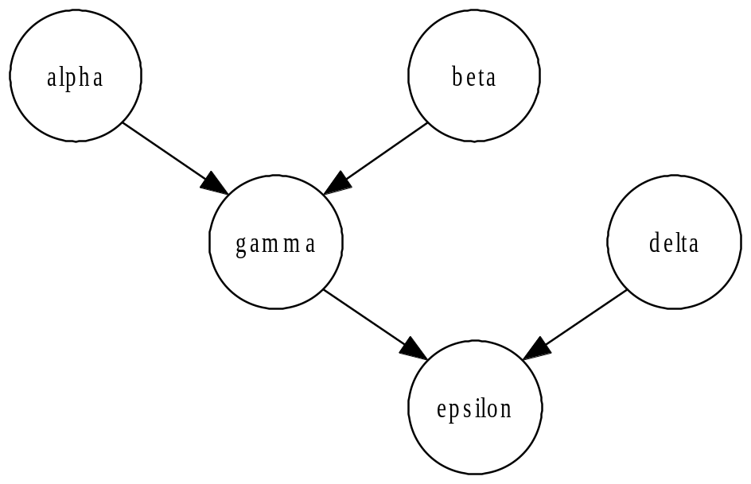
Task Parallelism Example
v = alpha();
w = beta();
x = gamma(v, w);
y = delta();
printf ("%6.2f\n", epsilon(x,y));
May execute alpha,
beta, and delta in
parallel

Slide 70
parallel sections Pragma
Precedes a block of k blocks of code that may be executed concurrently by k threads
Syntax:
#pragma omp parallel sections

Slide 71
‘section’ Pragma
Precedes each block of code within the encompassing block preceded by the parallel sections pragma
May be omitted for first parallel section after the parallel sections pragma
Syntax:
#pragma omp section

Slide 72
Example of parallel sections
#pragma omp parallel sections
{
#pragma omp section /* Optional */
v = alpha();
#pragma omp section
w = beta();
#pragma omp section
y = delta();
}
x = gamma(v, w);
printf ("%6.2f\n", epsilon(x,y));
NOTE: We reorder assignments to group three that can be executed in order.

Slide 73
Another Approach
Execute alpha and
beta in parallel.
Execute gamma and
delta in parallel.

Slide 74
sections Pragma
Appears inside a parallel block of code
Has same meaning as the parallel sections pragma
If multiple sections pragmas inside one parallel block, may reduce fork/join costs

Slide 75
Use of sections Pragma
#pragma omp parallel
{
#pragma omp sections
{
v = alpha();
#pragma omp section
w = beta();
}
#pragma omp sections
{
x = gamma(v, w);
#pragma omp section
y = delta();
}
}
printf ("%6.2f\n", epsilon(x,y));

Slide 76
Quinn Summary (1/3)
OpenMP an API for shared-memory parallel programming
Shared-memory model based on fork/join parallelism
Data parallelism
  parallel for pragma
  reduction clause

Slide 77
Quinn Summary (2/3)
Functional parallelism (parallel sections pragma)
SPMD-style programming (parallel pragma)
Critical sections (critical pragma)
Enhancing performance of parallel for loops
  Inverting loops
  Conditionally parallelizing loops
  Changing loop scheduling

Slide 78
Quinn Summary (3/3)
Characteristic | OpenM | MPI
Suitable for multiprocessors | Yes | Yes
Suitable for multicomputers | No | Yes
Supports incremental parallelization | Yes | No
Minimal extra code | Yes | No
Explicit control of memory hierarchy | No | Yes

Slide 79
Some Additional Comments

Slide 80
OpenMP Constructs
Limited to compiler directives and library subroutine calls.
The compiler directive format is such that they will be treated as comments by a sequential compiler.
This allows existing sequential compilers to easily be modified to support OpenMP
Whether a program executes the same computation (or any meaningful computation when executed sequentially) is the responsibility of programmer.

Slide 81
Starting & Forking Execution
Execution starts with a sequential process that forks a fixed number of threads when it reaches a parallel region.
This team of threads execute to the end of the parallel region and then join original process.
The number of threads is constant within a parallel region.
Different parallel regions can have a different number of threads.

Slide 82
OpenMP Synchronization
Handled by various methods, including
critical sections
single-point barrier
ordered sections of a parallel loop that have to be performed in the specified order
locks
subroutine calls

Slide 83
Parallelizing Programs Philosophies
Two extreme philosophies for parallelizing programs
In minimum approach, parallel constructs are only placed where large amounts of independent data is processed.
  Typically use nested loops
  Rest of program is executed sequentially.
  One problem is that it may not exploit all of the parallelism available in the program.
  The process creation and termination may be invoked many times and cost may be high.

Slide 84
Parallelizing Programs Philosophies (cont)
The other extreme is the SPMD approach, which treats the entire program as parallel code.
  Enters a parallel region at the beginning of the main program and exiting it just before the end.
  Steps serialized only when required by program logic.
Many programs are a mixture of these two parallelizing extremes.

